Slide 1


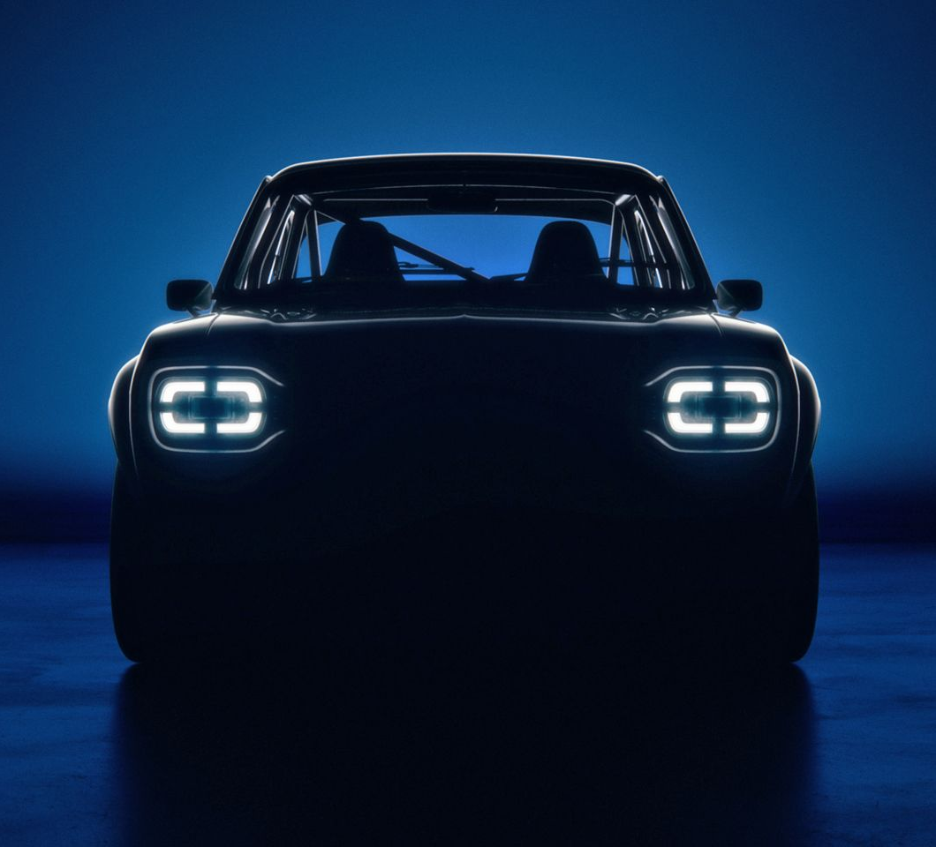
CARMAgeDDoN
Computer Vision and Machine Learning project

Slide 2
CARMAgeDDoN
Car
Analysis and
Recognition via
Machine-learning for
Automotive
Disambiguation with
Deep Learning
Networks

Slide 3
Project goals
Brand identification of car
Model identification of car
Ideally: Chassis-code identification (variants)
Support goals:
Usability of image (scoring)
Angle of image (scoring)

Slide 4
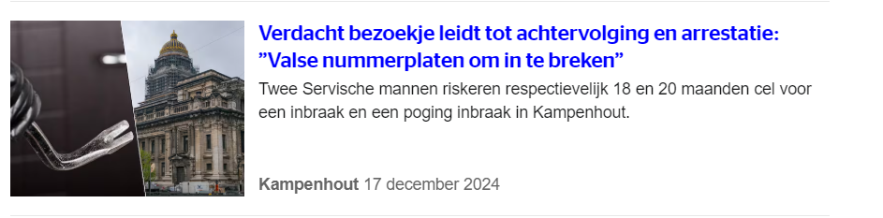
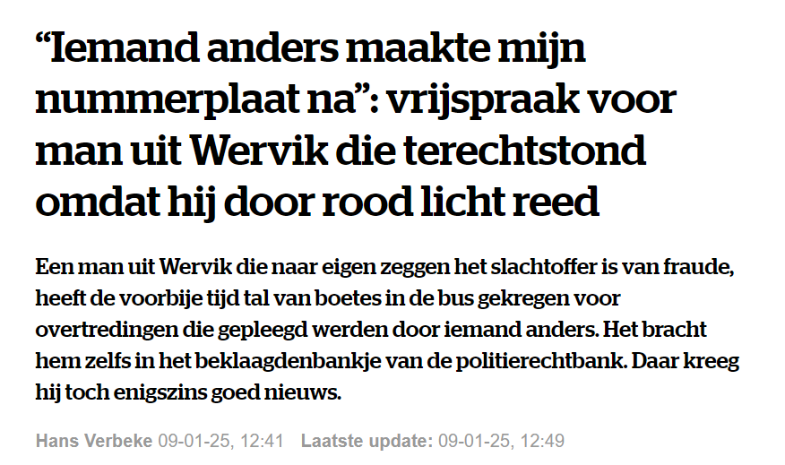
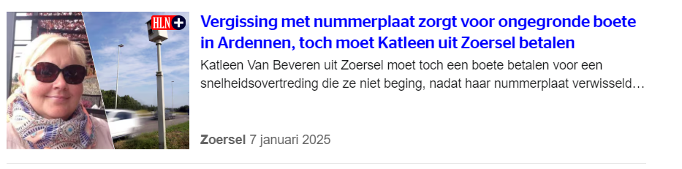
Impact
License plate fraude

Slide 5
Impact
License plate fraude
LEZ
MOT-stations
ANPR-verrification
App (ObsIdentify for cars)
…

Slide 6
DATA (sourcing)
Downsized proposal from larger idea
Autoscout
Listings:
Images
Brand
Model / model ID
Support features
Autodoc
Chassis codes
There be dragons:
Data linking

Slide 7
Data description & EDA

Slide 8
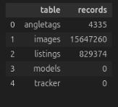


15,6 million images (839GB)
829 thousand listings

Slide 9
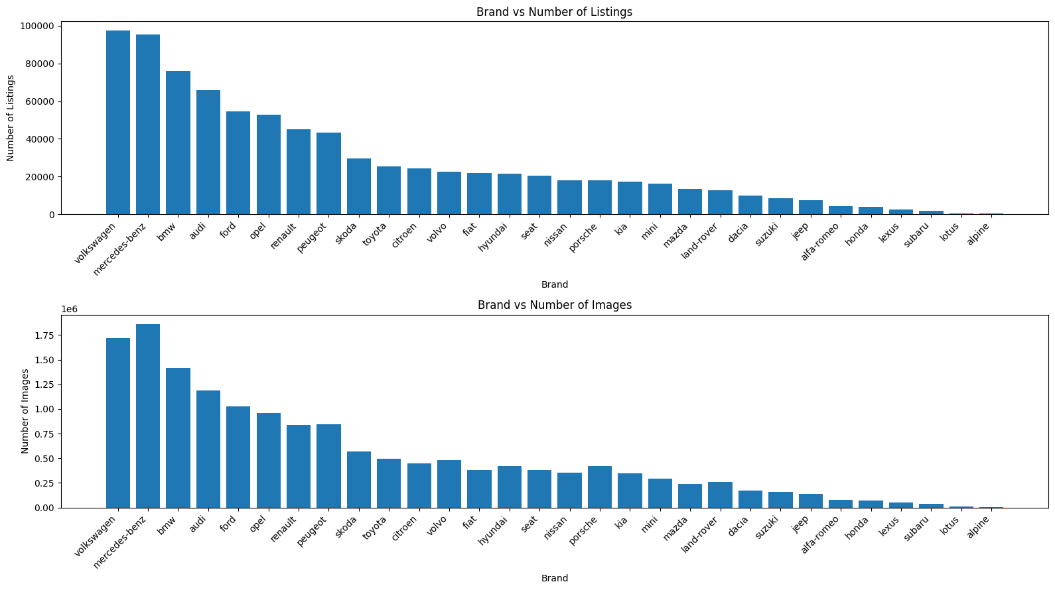

Slide 10
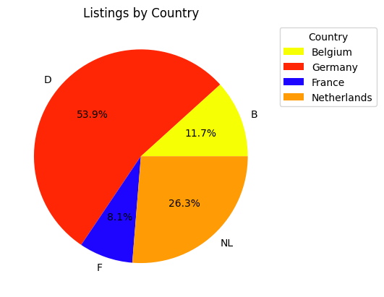

Slide 11
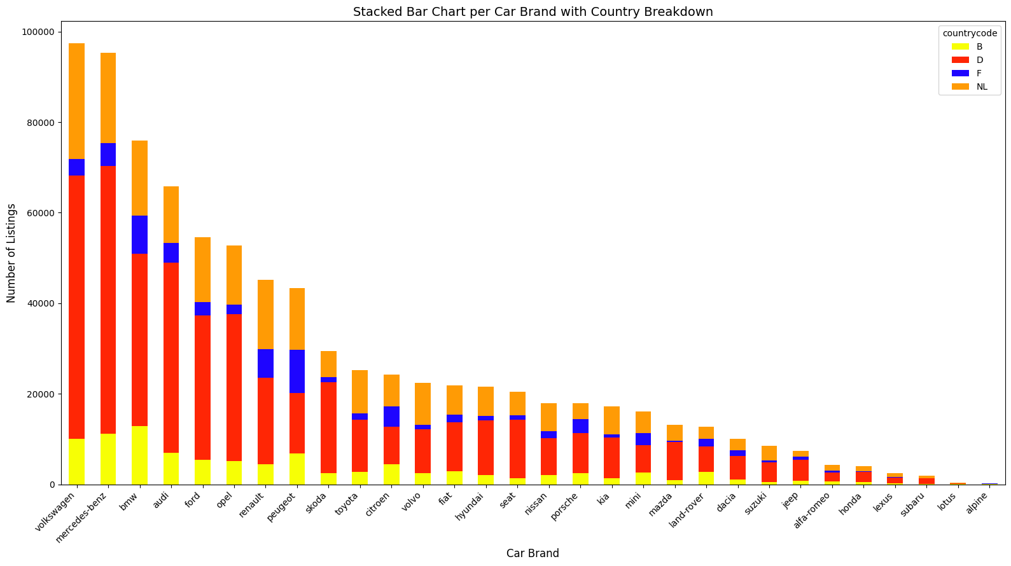

Slide 12
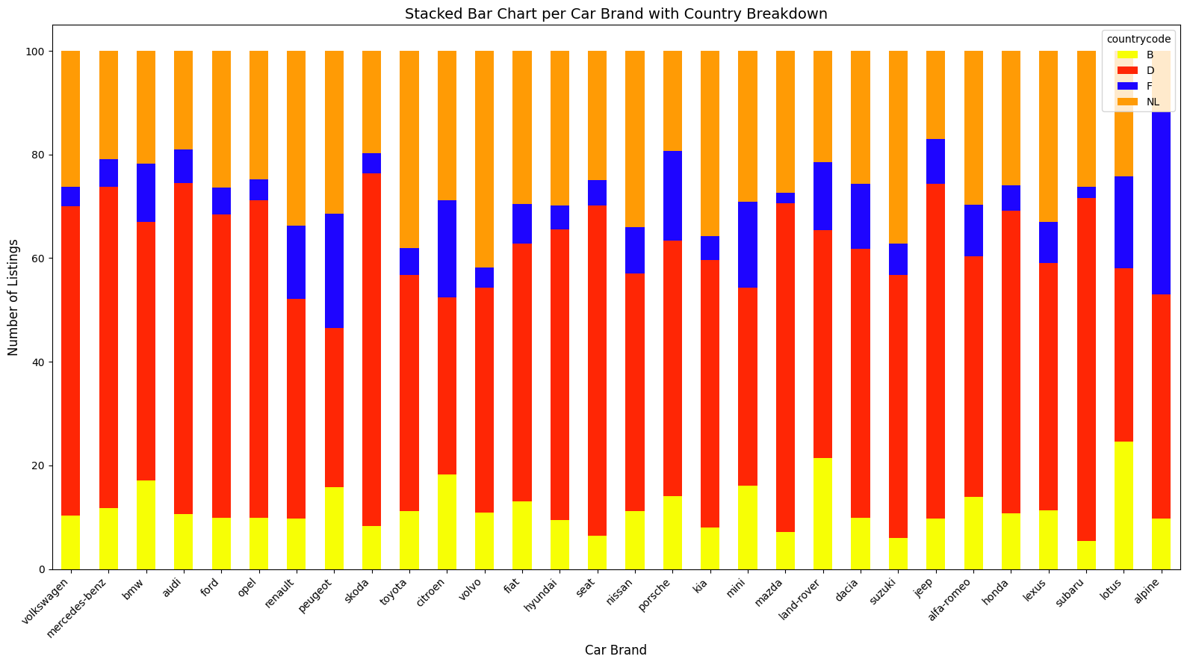

Slide 13
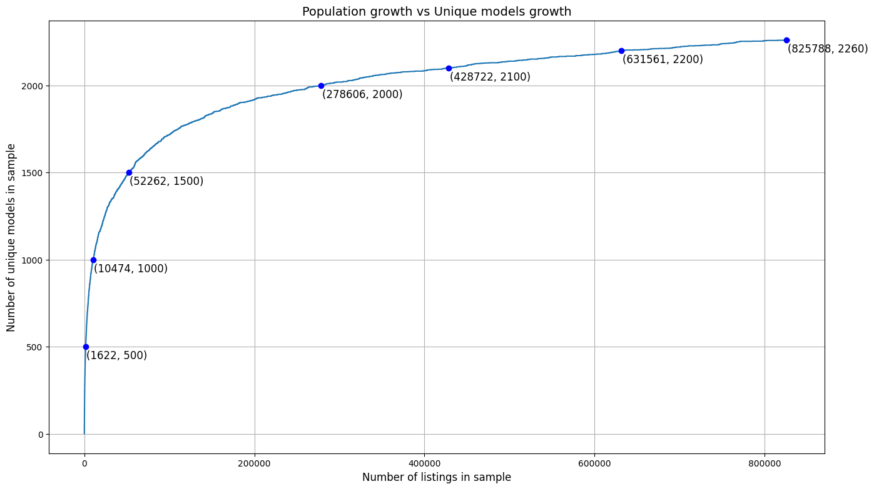

Slide 14
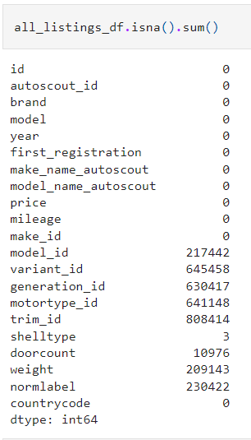



Slide 16
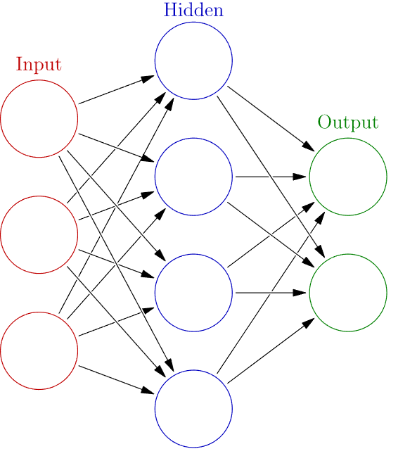


Deliverable pipeline
CNN1:
Bin tag
angle tag
CNN2:
brand classification
Bounding box:
x1,y1
x2,y2
CNN3a:
Model classification (audi)
CNN3b:
Model classification (fiat)

Slide 17

Here be dragons

